Slide 1
Chapter 5: The LC-3
Source:
Introduction to Computing Systems from bits & gates to C & beyond (McGraw-Hill, 2004)
COSC221: Computer Organization I

Slide 2
Topics for Discussion
ISA Overview
Operate Instructions
Data Movement Instructions
Control Instructions
COSC221: Computer Organization I

Slide 3
ISA Overview
ISA specifies the memory organization, register set, and instruction set, including opcodes, data types, and addressing modes
  Everything a programmer needs to know to write programs in the computer’s own machine language
COSC221: Computer Organization I

Slide 4
LC-3 Memory Organization
Address space = 2¹⁶ = 65536 locations
Addressability = 16 bits
Word length = 16 bits
COSC221: Computer Organization I

Slide 5
LC-3 Registers
LC-3 uses the general purpose register set (register file)
  Consists of eight general purpose registers (GPRs)
  R0, R1, …, R7
  Uses a 3-bit register number
COSC221: Computer Organization I

Slide 6
The LC-3 Instruction Set
Each instruction consists of opcode and operands
An instruction set is defined by:
  Its set of opcodes
  Data types
  Addressing modes
    Determine where operands are located
COSC221: Computer Organization I

Slide 7
LC-3 Opcodes
15 unique instructions ➔ 15 instructions
Opcode occupies bits [15:12] of instruction
  Opcode = 1101 is unassigned
Three types of opcodes
  Operates
  Data movement
  Control
COSC221: Computer Organization I

Slide 8
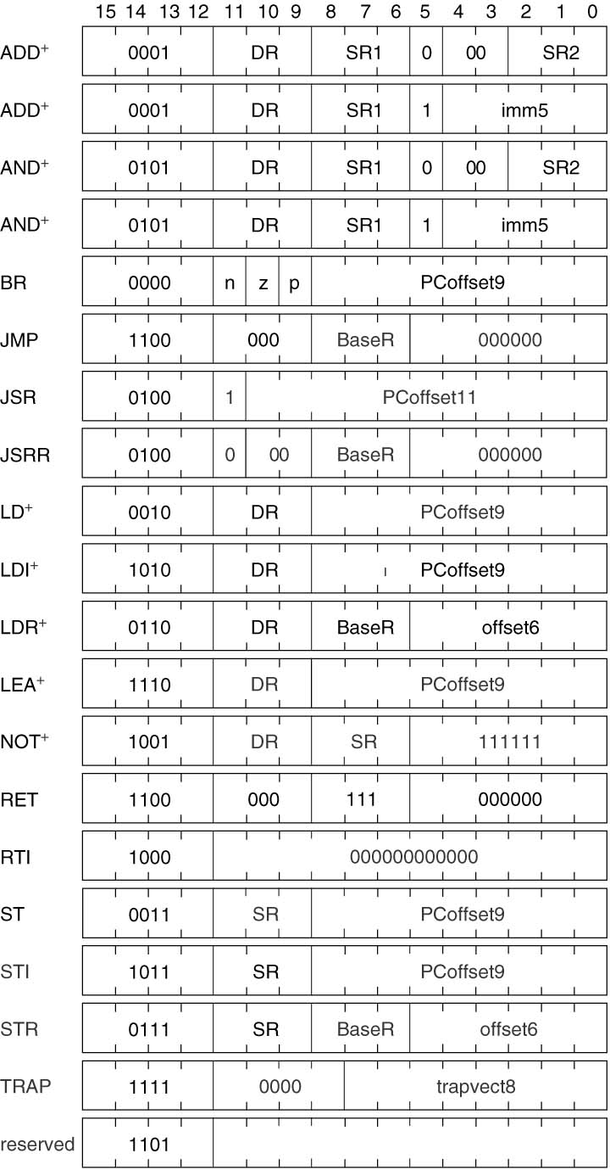
Formats of the LC-3 Instruction Set
COSC221: Computer Organization I

Slide 9
LC-3 Data Types
A data type is a representation of information
2’s complement integers
  Only data type supported by LC-3
COSC221: Computer Organization I

Slide 10
LC-3 Addressing Modes
An addressing mode is a mechanism for specifying where the operand is located
Possible operand locations:
  in memory
  in a register
  part of the instruction
COSC221: Computer Organization I

Slide 11
LC-3 Addressing Modes
Immediate (or literal)
  Operand is part of the instruction
Register
  Operand in a register
Memory addressing modes
  PC-relative
  Indirect
  Base + offset
COSC221: Computer Organization I

Slide 12
LC-3 Condition Codes
Used by control instructions to change the execution sequence
Condition codes:
  N (negative) register
  Z (zero) register
  P (positive) register
Individually set to a 0 or 1 each time a GPR is written
COSC221: Computer Organization I

Slide 13
LC-3 Operate Instructions
NOT (opcode = 1001)
  Unary operation
    Requires only one source operand
  Uses register addressing mode for both source and destination operands
  Format:
    Bits [15:12] = always the opcode
    Bits [11:9] = destination register
    Bits [8:6] = source register
    Bits [5:0] = all 1s
COSC221: Computer Organization I

Slide 14
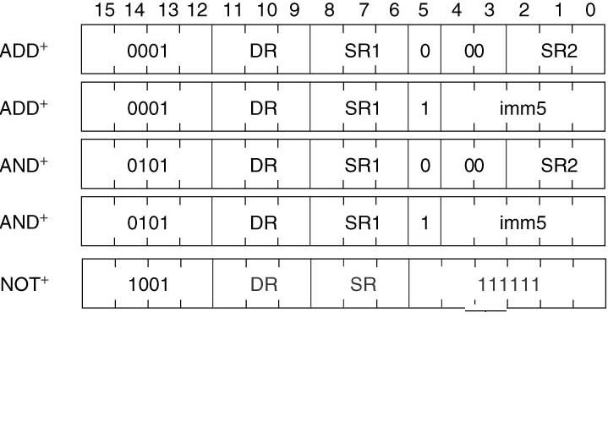
LC-3 Operate Instructions
COSC221: Computer Organization I

Slide 15
LC-3 Operate Instructions
ADD (opcode = 0001) and AND (opcode == 0101)
  Binary operations
    Requires two source operands
  One source operand and the destination operand uses register addressing mode
  Second source operand can be specified by either register mode or as an immediate operand
    Bits [15:12] = always the opcode
    Bits [11:9] = destination register
    Bits [8:6] = source register
    Bit [5] = determines which mode second source operand uses
      If Bit [5] = 0 : second source operand uses a register
      Bits [2:0] = second source register
      Bits [4:3] = all 0s
      If Bit[5] = 1 : second source operand uses immediate operand
      Bits [4:0] = sign extended to 16-bits to obtain second source operand
COSC221: Computer Organization I

Slide 16
Data Movement Instructions
Move information between GPRs and memory, and between GPRs and I/O devices
Load: moving information from memory to register
Store: moving information from register to memory
Load and store instructions do not affect the contents of the source operand and overwrites the previous contents of the destination operand
COSC221: Computer Organization I

Slide 17
LC-3 Data Movement Instructions
LEA (opcode = 1110)
LD (opcode = 0010)
ST (opcode = 0011)
LDI (opcode = 1010)
STI (opcode = 1011)
LDR (opcode = 0110)
STR (opcode = 0111)
Two operands: one source and one destination
Format:
  Bits [11:9] = register operand, either DR or SR
  Bits [8:0] = address generation bits used to compute the 16-bit address of the second operand
  Addressing mode used is specified by the opcode
COSC221: Computer Organization I

Slide 18
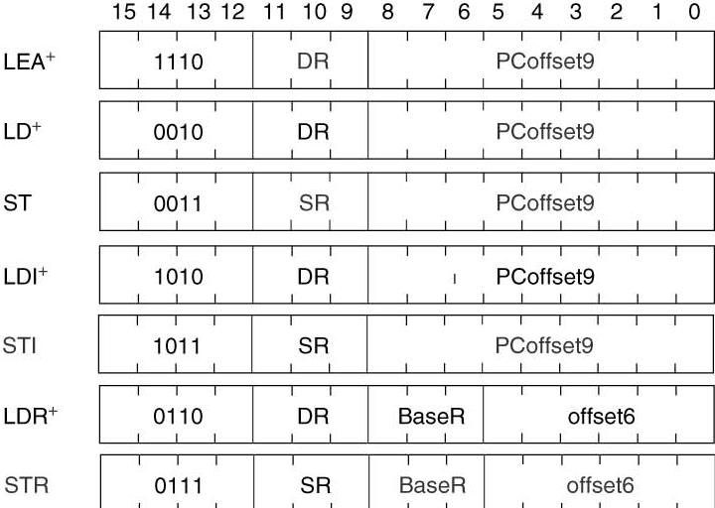
Data Movement Instructions
COSC221: Computer Organization I

Slide 19
Immediate (Literal) Addressing Mode
Used in Load Effective Address (LEA) instruction
  opcode = 1110
  Load specified register with immediate value
    DR specified by bits [11:9]
    Immediate operand = (PC + 1) + SEXT Bits [8:0]
  No memory access performed
Useful in loading the address of a memory location into a register
COSC221: Computer Organization I

Slide 20
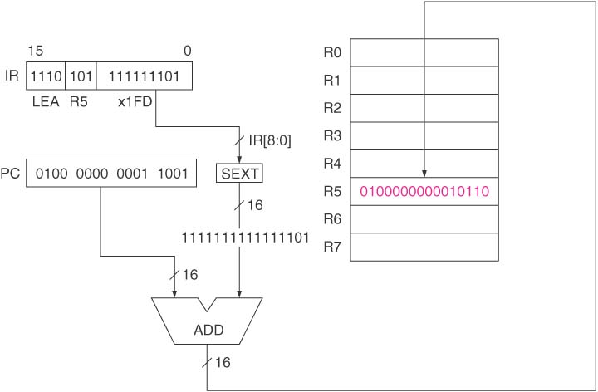
Figure 5.9 LEA R5, #-3
COSC221: Computer Organization I

Slide 21
PC-Relative Addressing Mode
Used in Load (LD) and Store (ST) instructions
LD: opcode = 0010
  Load a register with value read from memory
  DR specified by bits [11:9]
  Value to be loaded is obtained from memory address computed by
    (PC+1) + 16-bit SEXT Bits [8:0]
ST: opcode = 0011
  Store in a memory location a value stored in register
  SR specified by bits [11:9]
  Destination memory address computed by
    (PC+1) + 16-bit SEXT Bits [8:0]
COSC221: Computer Organization I

Slide 22
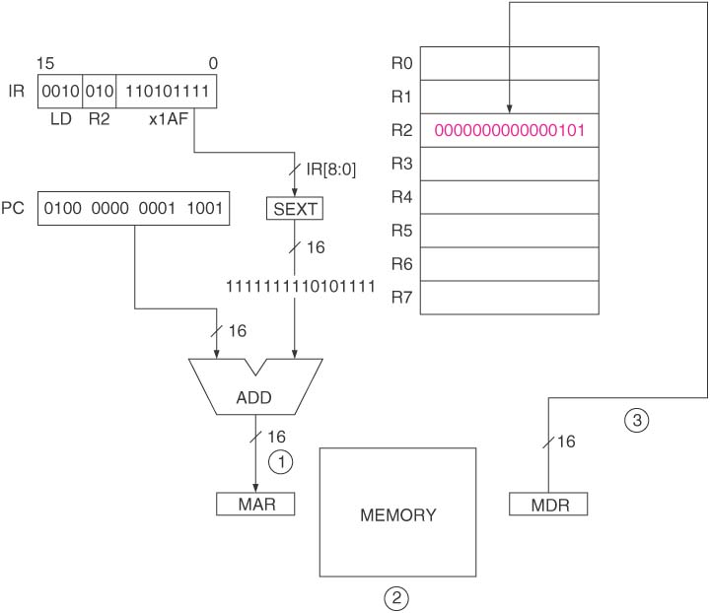
Figure 5.6 LD R2, x1AF
COSC221: Computer Organization I

Slide 23
Indirect Addressing Mode
Used in Load Indirect (LDI) and Store Indirect (STI) instructions
LDI: opcode = 1010
  Load a register with value read from memory
  DR specified by bits [11:9]
  Value to be loaded is obtained from memory location computed by (PC+1) + 16-bit SEXT Bits [8:0] refers to the address of the memory operand
STI: opcode = 1011
  Store in a memory location a value stored in register
  SR specified by bits [11:9]
  Destination memory address is specified by the contents of the memory location whose address is computed by
    (PC+1) + 16-bit SEXT Bits [8:0]
COSC221: Computer Organization I

Slide 24
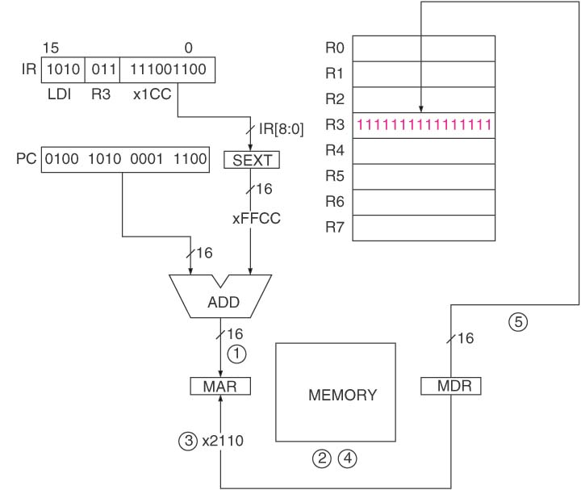
Figure 5.7 LDI R3, x1CC
COSC221: Computer Organization I

Slide 25
Base+offset Addressing Mode
Used in Load Base+offset (LDR) and Store Base+offset (STR) instructions
LDR: opcode = 0110
  Load a register with value read from memory
  DR specified by bits [11:9]
  Value to be loaded is obtained from the memory location whose address is computed by
    Base register specified by Bits [8:6] + 16-bit SEXT Bits [5:0]
STR: opcode = 0111
  Store in a memory location a value stored in register
  SR specified by bits [11:9]
  Destination memory address is computed by
    Base register specified by Bits [8:6] + 16-bit SEXT Bits [5:0]
COSC221: Computer Organization I

Slide 26
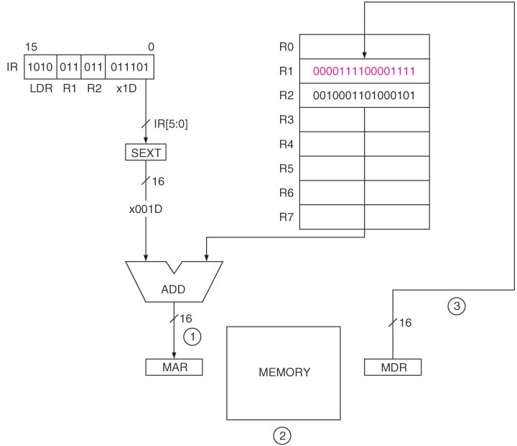
Figure 5.8 LDR R1, R2, x1D
COSC221: Computer Organization I

Slide 27
Control Instructions
Conditional instructions change the sequence of the instructions that are executed
Default is execution of instructions in sequential memory locations
  PC is incremented in each FETCH phase
Five LC-3 Control Instructions
  Conditional Branch (BR): opcode = 0000
  Unconditional Jump: opcode = 1100
    Jump(JMP)
    Return from Subroutine (RET)
  Subroutine (function) call: opcode = 0100
    Jump to Subroutine (JSR, JSRR)
  TRAP: opcode = 1111
  Return from Interrupt ( RTI): opcode = 1000
COSC221: Computer Organization I

Slide 28
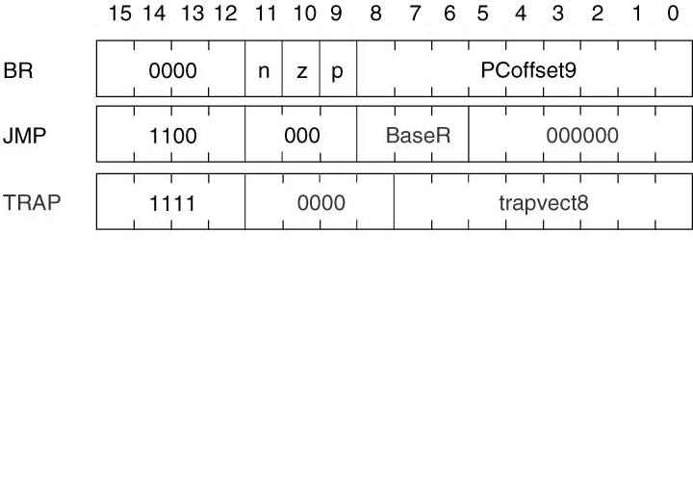
Control Instructions
COSC221: Computer Organization I

Slide 29
Conditional Branches
BR (opcode = 0000)
Uses the condition codes (N, Z, P) to determine whether or not to change instruction flow
  Bit [11] specifies if condition code N should be examined
  Bit [10] specifies if condition code Z should be examined
  Bit [9] specifies if condition code P should be examined
If at least one of the condition codes examined is 1, then the value of PC is obtained by
  (PC = PC +1) + SEXT Bits [8:0]
Only allows branches (jumps) to instructions within +255 or -256 instructions from the branch instruction itself
COSC221: Computer Organization I

Slide 30
The JMP Instruction
JMP: opcode = 1100
Loads the PC with the contents of the register specified by bits [8:6] of instruction
Bits [11:9] and [5:0] are all 0s
Allows jumping to any of the 2¹⁶ memory locations (entire address space)
COSC221: Computer Organization I

Slide 31
The TRAP Instruction
TRAP: opcode = 1111
Changes the PC to a value which corresponds to an OS service subroutine such read character from keyboard or write a character to the console (display)
More on this in Chapter 9
COSC221: Computer Organization I

Slide 32
LC-3 Data Path
COSC221: Computer Organization I

Slide 33
Basic Components of the Data Path
Global Bus
  Allows transfer of 16 bits of information between two structures at a time
  Tri-state device allows the computers control logic to enable exactly one supplier to provide information to the bus at any one time
Memory
  Uses the MAR and MDR registers to access memory locations
  WE controls writing to memory location
COSC221: Computer Organization I

Slide 34
Basic Components of the Data Path (continued)
ALU and Register File
  Two inputs: one from a register and the second could either from another register or the sign-extended immediate value provided by the instruction
  Select line from bit [5] of instruction chooses the second input
PC and PCMUX
  PC supplies value to MAR
  PCMUX chooses next value of PC
    Incremented, result of control instruction, or from global bus
MARMUX
  Chooses where to get value for MAR
    From incremented value of PC or result of base register + literal value
COSC221: Computer Organization I

Slide 35
The Instruction Cycle
FETCH
DECODE
EVALUATE ADDRESS
OPERAND FETCH
EXECUTE
STORE RESULT
COSC221: Computer Organization I

Slide 36
Reading Assignment
Chapter 6 Programming
COSC221: Computer Organization I

